Slide 1

lesson 3
Standard Methods
of Input

Slide 2
This lesson includes the following sections:
    The Keyboard
    The Mouse
    Variants of the Mouse

Slide 3
The Keyboard
The Standard Keyboard Layout
Ergonomic Keyboards
How a Keyboard Works

Slide 4
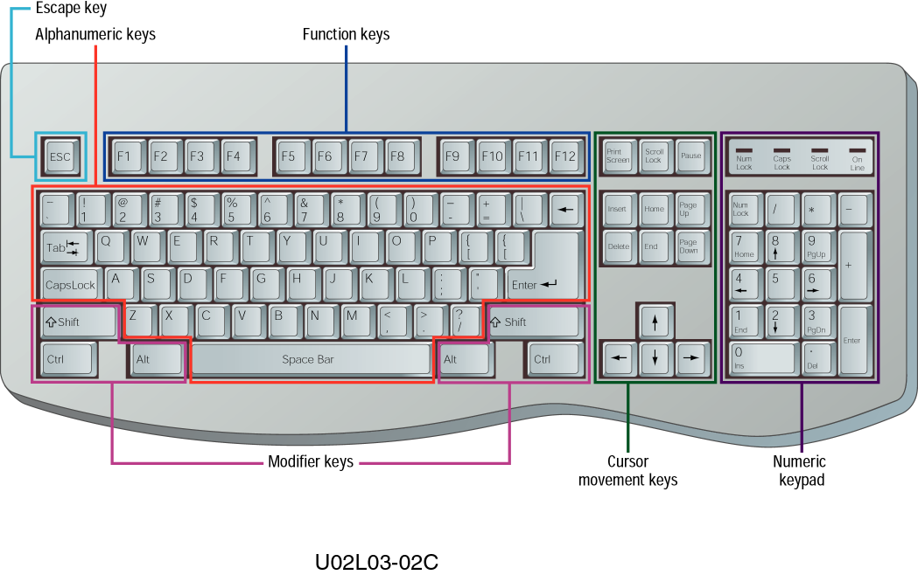
The Keyboard - Standard Keyboard Layout
A standard computer keyboard has about 100 keys.
Most keyboards use the QWERTY layout, named for the first six keys in the top row of letters.

Slide 5
The Keyboard - Standard Keyboard Layout
Most keyboards have keys arranged in five groups:
1. Alphanumeric keys
2. Numeric keypad
3. Function keys
4. Modifier keys
5. Cursor-movement keys

Slide 6
ACADEMIC RECORDS
Password
*
*
*
*
*
ENTER
Invalid Password

Slide 7
The Keyboard - Ergonomic Keyboards
Long periods of keyboard use can cause injuries.
An ergonomically correct keyboard can help you avoid injuries.
You also can avoid injuries by adopting correct keyboarding practices.

Slide 8
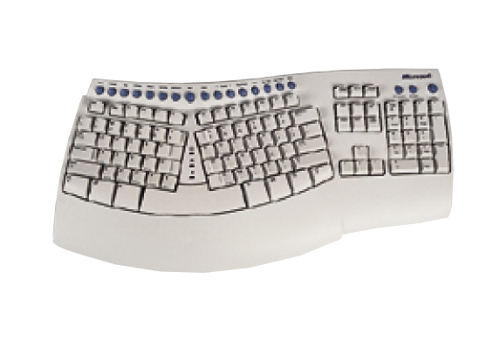
Ergonomic style

Slide 9
The Keyboard - How a Keyboard Works
When you press a key:
The keyboard controller detects the keystroke.
The controller places a scan code in the keyboard buffer, indicating which key was pressed.
The keyboard sends the computer an interrupt request, telling the CPU to accept the keystroke.

Slide 10
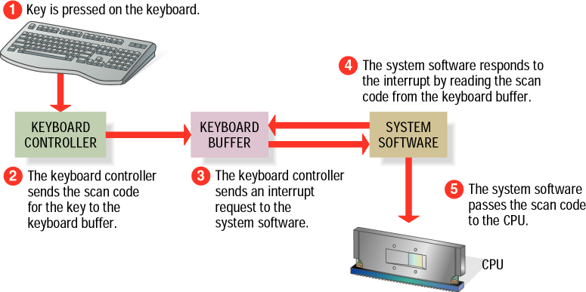

Slide 11
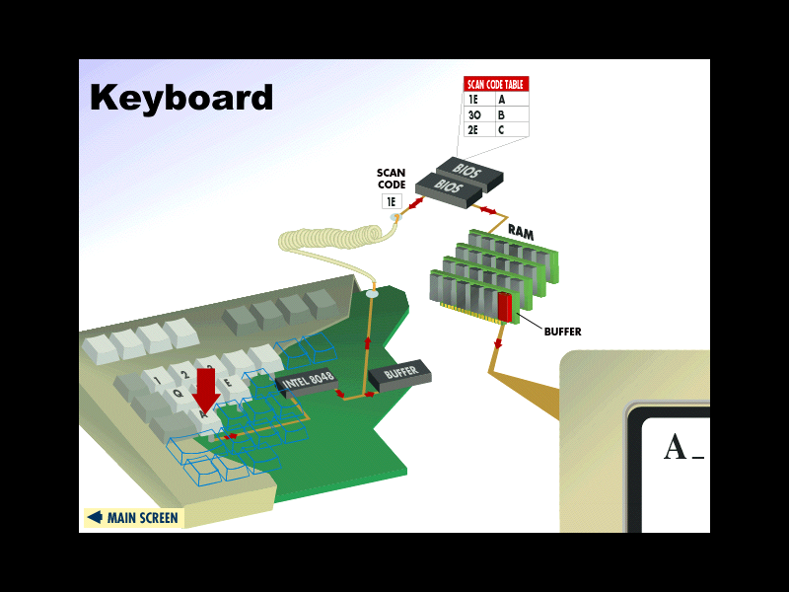

Slide 12

The Mouse
What is a Mouse?
Mouse Techniques

Slide 13
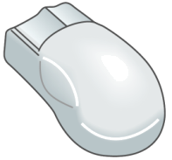
The Mouse - What is a Mouse?
The mouse is a pointing device. You use it to move a graphical pointer on the screen.
The mouse can be used to issue commands, draw, and perform other types of input tasks.

Slide 14
The Mouse - Mouse Techniques
Using the mouse involves five techniques:
Pointing; Move the mouse to move the on-screen pointer.
Clicking; Press and release the left mouse button
once.
Double-clicking; Press and release the left mouse
button twice.
Dragging; Hold down the left mouse button as you
move the pointer.
Right-clicking; Press and release the right mouse button.

Slide 15
Variants of the Mouse
Trackballs
Trackpads
Integrated Pointed Devices

Slide 16
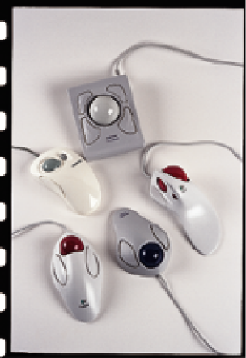
Variants of the Mouse - Trackballs
A trackball is like a mouse turned upside-down.
Use your thumb to move the exposed ball and your fingers to press the buttons.
      Many styles of trackball are available.

Slide 17
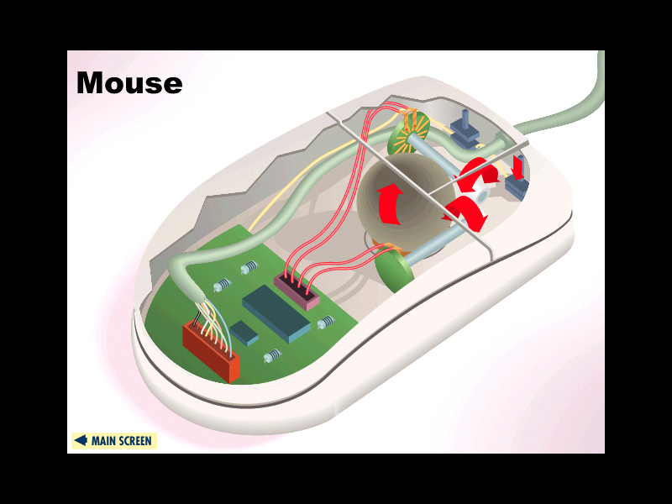

Slide 18
Variants of the Mouse - Trackpads
A trackpad is a touch-sensitive pad that provides the same functionality as a mouse.
To use a trackpad, you glide your finger across its surface.
Trackpads provide a set of buttons that function like mouse buttons.

Slide 19
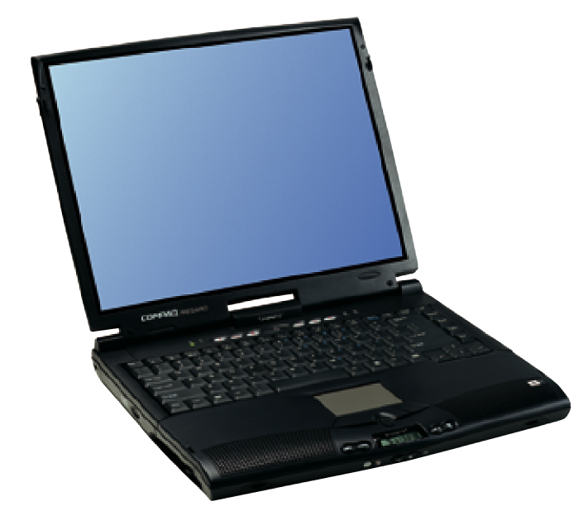
Peter Norton's
Introduction to Computers

Slide 20
Variants of the Mouse-
Integrated Pointing Devices
An integrated pointing device is a small joystick built into the keyboard.
To use an integrated pointing device, you move the joystick.
These devices provide a set of buttons that function like mouse buttons

Slide 21
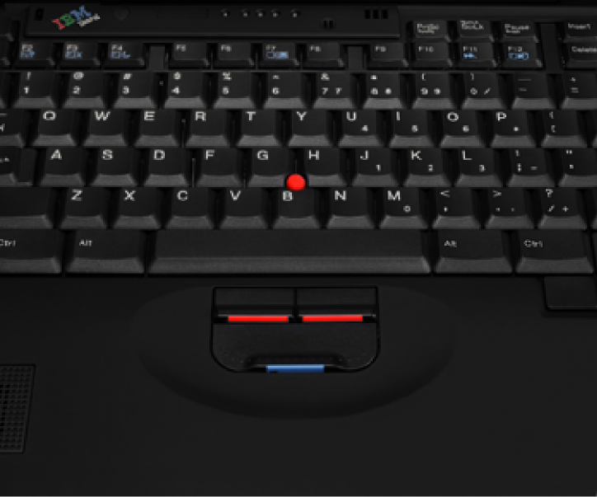

Slide 22
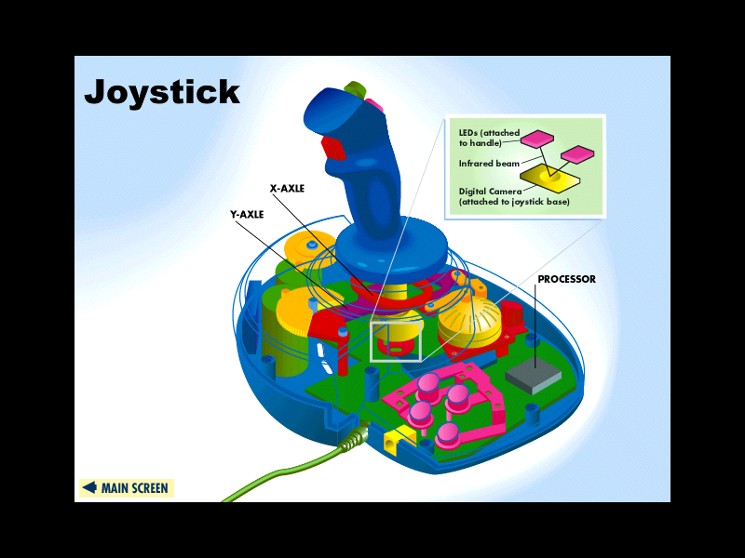

Slide 23
lesson 3 Review
Identify the five key groups on a standard computer keyboard.
Describe the purpose of a mouse and the role it plays in computing.
Identify the five essential techniques for using a mouse.
Identify three common variants of the mouse.

